Slide 1
Solving Problems of pricing Used Car
A showcase of how problems of pricing used cars can be resolved by utilizing the power of data

Slide 2
Agenda
1
State the Problem
2
Define the Workflow
3
Conduct the Analysis
4
Interpret the Results

Slide 3
1
State the Problem

Slide 4
Stating the problem well is key to a good problem-solving
Problem Statement
The sales team of a used car dealership in the UK has encountered problems in pricing the used cars arrived at the dealership. We need to be able to predict the prices of used cars with a positive prediction error less than £1500. If the prediction works well, the company will formulate further strategies based on the findings.
Motivation
By solving the problem, we can enjoy the following benefits:
More accurate prices
Less unsalable cars
Deeper understanding about factors that affect prices
As a results, the sales team can:
Generate more profits
Reach higher inventory turnover rate
Be more confident about relationships between the conditions of the cars and their prices
Goals
A model capable of predicting prices of used car
Insights about key factors that determine the predicted prices
Notes:
Inventory turnover indicates the rate at which a company sells and replaces its stock of goods during a particular period.

Slide 5
2
Define the Workflow

Slide 6

Defining the workflow helps improving the overall quality and alignment to the goal
Prepare Data
Interpret Results
Build the Model
Preparation
Preprocessing
Outcomes
Future Work
Exploratory Data Analysis
Data Cleaning
Modeling
Model Selection
Data Used: Data from other retailers on the prices of Toyota cars
Programming Language Used: Python

Slide 7
3
Conduct the Analysis

Slide 8
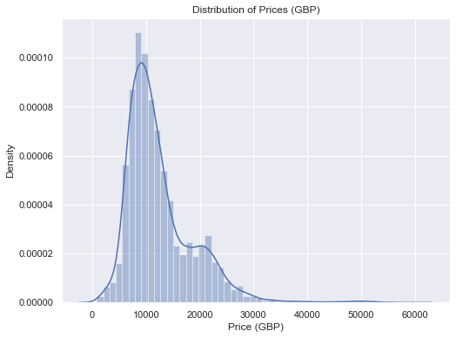
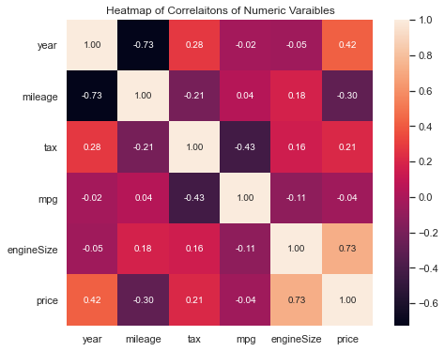
Exploratory Data Analysis enables us to gain insights from the data
Notes:
By doing Exploratory Data Analysis, we can have more understanding about the data and relationships among the factors.
First, we may want to see our target, which the price of the cars. On the left-hand side, here is a distribution chart of percentage of car amount across prices.
Most cars of prices in the range of 5000 pounds and 20000 pounds, and cars priced 10000 pounds appear the most frequently in the data.
Of course, we also want to see the relationships between the factors and the price. So, I drew a heatmap of correlations of them. Correlations tell us about how close two factors are.
For example, in the first green square, we can see price and year has a medium correlation, it means newer cars come with moderately higher price.
In the second green square, we can see that price and engine size have a high correlation, meaning that cars with bigger engine sizes usually cost more.

Slide 9
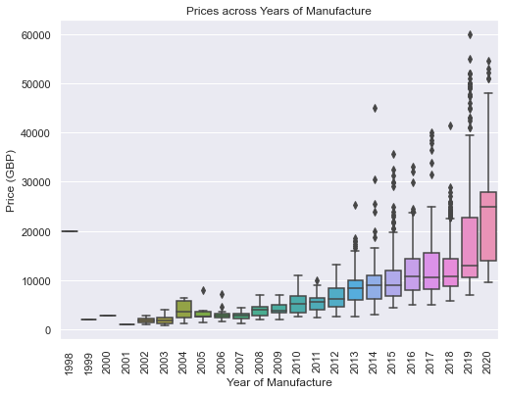
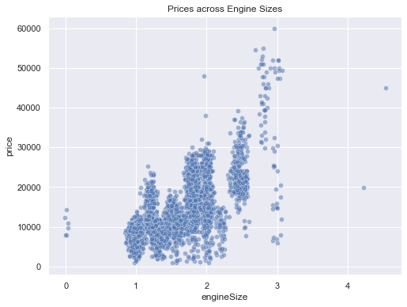
Exploratory Data Analysis enables us to gain insights from the data
Notes:
Based on the two green squares, we want to see more details.
Upward trends → newer cars are more expensive
Upward trends → cars with bigger engines are more expensive

Slide 10
Building a linear regression model empowers to achieve the defined goals
Metric
Mean Absolute Error (MAE):
The mean of the absolute differences between the actual values and the predictions.
It tells us, on average, how far away our predictions are from the actual values, and our goal is to make it < £1500
Model Chosen
Multiple Linear Regression:
Multiple: the model considers many factors like year, mileage, car models, etc.
Linear: a linear line on a plot can represent the model.
Regression: think it as name of the model.
The weights of the factors give us information about the importance of each factor.
Ensuring Performance
We split the data into train and test sets. Then, we train the model using the train set and test it using the test set.
It is like teaching students using exercises.
Notes:
Now it is time to build the model.
Before we build our model, we need to define the metric first. A metric is a calculation method we use to measure the performance of a model.
Here, I chose Mean Absolute Error (MAE) as our metric. It basically tells us, on average, how far away our predictions are from the actual values. Recall from our problem statement, we want this number smaller than 1500 pounds.
Let me give you an analogy. Let’s say that you are shooting targets. If all the arrows hit the bullseye, then the MAE would be 0. If not, we can measure the distance between the center and where your arrow lands to have a number to tell how accurate your shooting skill is.
After the metric is defined, we can move on to choosing the right model.
Here, I chose the multiple linear regression model, because it is easy to implement and easy to understand.
The name sounds scary, but if we break it down, we can understand it pretty well. Multiple means the models uses many factors like year, mileage, car models, etc. Linear means that if we plot the model on a plot, it can be represented by a straight line. As regression, you can think of it as the last name of the model, because there are also other types of regression.
On great benefit of using this model is that the weights the models give to the factors can be interpreted and we can know importance of the factors presented in the data.
When training the model, in order to ensure the model’s predictability. We split the data into train and test sets. Then, we train the model using the train set and test it using the test set.
It is like teaching students using exercises. Let’s say you are a teacher and you have one hundred exercises. You give the students 90 exercises along with answers, so that they can learn about the topic you are teaching. Later on, you use the rest 10 exercises to test if they learn well. Simple as that.

Slide 11
4
Interpret the Results

Slide 12
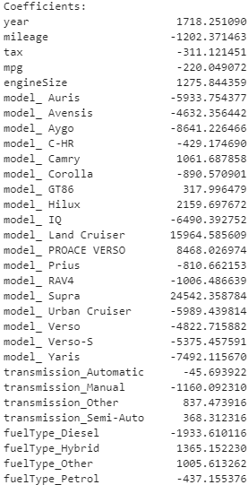
Interpreting model performance gives insightful information
Model Performance
Mean Absolute Error (MAE) on the test data is 1079.65.
On average, our predictions deviate from the actual prices by around £1000.
Factor Importance
Year: A bigger year value means a higher price and the coefficient is large compared to others → Newer cars are more expensive and year is an important factor
Mileage: A higher mileage means a lower price and the absolute value of the coefficient is large → More used cars worth less and mileage is an important factor
Engine Size: Bigger engine size yields higher price → Cars with bigger engines worth more
Model: Some models like Supra and Land Cruiser have very high coefficients. → Premium models cost more
Fuel Type: Hybrid has higher coefficient than Diesel and Petrol do → Hybrid cars are usually more premium.
Notes:
The model performs pretty well.
The MAE is around 1000 pounds, which means that, on average, our predictions deviate from the actual prices by around 1000 pounds. This number is lower than 1500 pounds threshold so it’s great.
If we look into the details of the model, we can some insights. Especially, the coefficients assigned to different factors tell us about the importance of those factors.
For example, the number for “year” is positive and big, and this tells us that newer cars indeed are more expensive, and the year of manufacture is an important indicator.
As for mileage, the number is negative and its absolute value is big. This tells us that a more used car usually worth less and mileage is also an important indicator.
Engine size, again, positive and big, so cars with bigger engines sizes worth more.
Another interesting fact is that models like supra and land cruiser have high coefficient. This makes sense because these are premium models, and premium models cost more.
Last, looking at the fuel type, we found that Hybrid has higher coefficient than Diesel and Petrolium do. It could be that Hybrid cars are usually of premium models.

Slide 13





Future work lays the foundations for a better future
A more diverse data
A more solid EDA
Testing on more models
An easy-to-use UI
Classes for the sales team

Slide 14
Thank you
Feel free to ask me any question you have!

